Slide 1

SQL Bootcamp
On Lighthall.co
By Thoufiq Mohammed (techTFQ)
2023 – Cohort 1 (01-Feb-2023 to 16-Mar-2023)

Slide 2
Important links
Refer my website https://techtfq.com/sql-bootcamp for complete details about the bootcamp.
Also refer to the FAQ document on Lighthall below: https://lighthall.notion.site/Frequently-Asked-Questions-7f41ad13720042a4a89785f2b5e22d4d

Slide 3
Pre-Requisites
Install a RDBMS such as PostgreSQL, MySQL, Oracle, Microsoft SQL Server etc.
Install an IDE such as PgAdmin, MySQL Workbench, SQL Developer, Microsoft SQL Server Management Studio etc.

Slide 4
Which role can you target after learning SQL from this Bootcamp ?
Data Analyst
Data Engineer
Data Scientist
SQL Developer
Business Analyst
Software Engineer
Quality Analyst
Etc…

Slide 5
Why are you learning SQL ?
How much SQL should you learn ?
The right approach to learn SQL?

Slide 6
“Let’s keep the class interactive” Ask questions!!! “Help each other”

Slide 7
Basic Terminologies
Data
Database (Relational Database)
RDBMS
SQL / Sequel / Structured Query Language
Table
Column
Rows / Record
Query / Statement

Slide 8
Data
Anything & Everything can be considered as data.
Any information or fact can be considered as data.
For an insurance company, details related to its employees, customers, their products or even their address can be data.
Data can be in any form such as a text message or an image or a video or a document or single character itself.

Slide 9
Database
Container which is filled with data or information which is electronically stored in a computer system.
Data in any form can be stored in the database.
All companies use some sort of database to store their data.
Purpose of storing data in the database is:
Easily Accessed
Modified
Protected
Analyzed

Slide 10
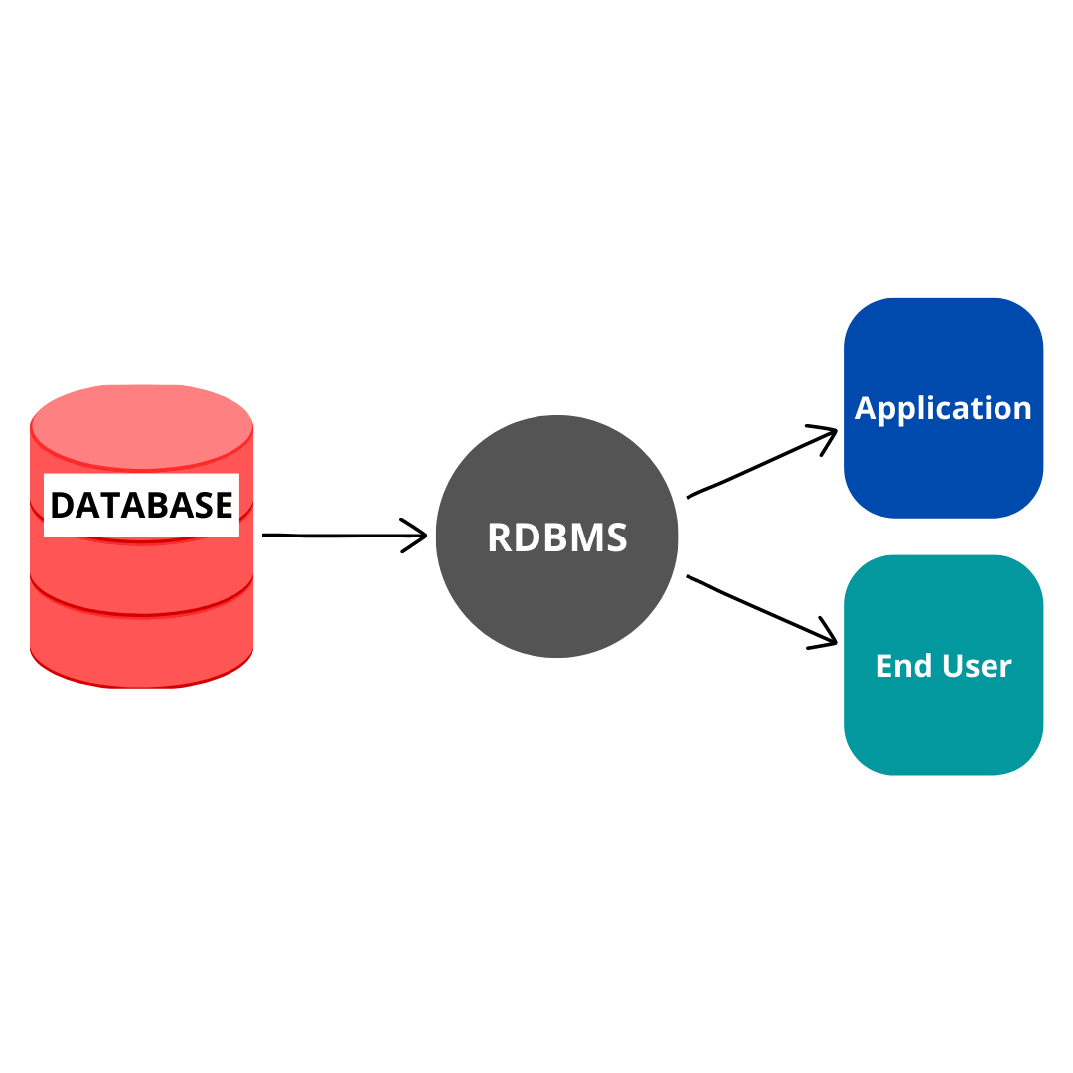
RDBMS vs DATABASE

Slide 11
SQL
Structured Query Language (SQL). Also referred to as “SEQUEL”
SQL is a programming language used to interact with Relational Database Management System.
SQL is primarily used in RDBMS.
All major RDBMS like Oracle, MySQL, MSSQL, PostgreSQL etc use SQL.
Using SQL, you can:
Read data from a RDBMS
Write data into a RDBMS
Create, modify or delete database
Analyze data
Build reports

Slide 12
How is data stored in RDBMS ?
In RDBMS, data is stored in multiple tables.
Each table can have a set of rows and columns.
Different tables will be related to each other through certain columns forming relationship between these tables.

Slide 13
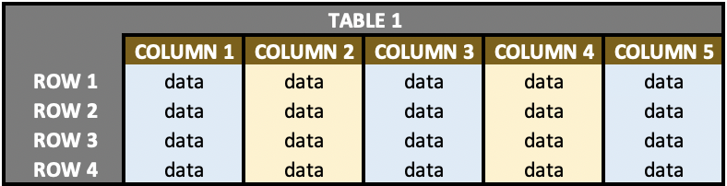
Sample data in table

Slide 14
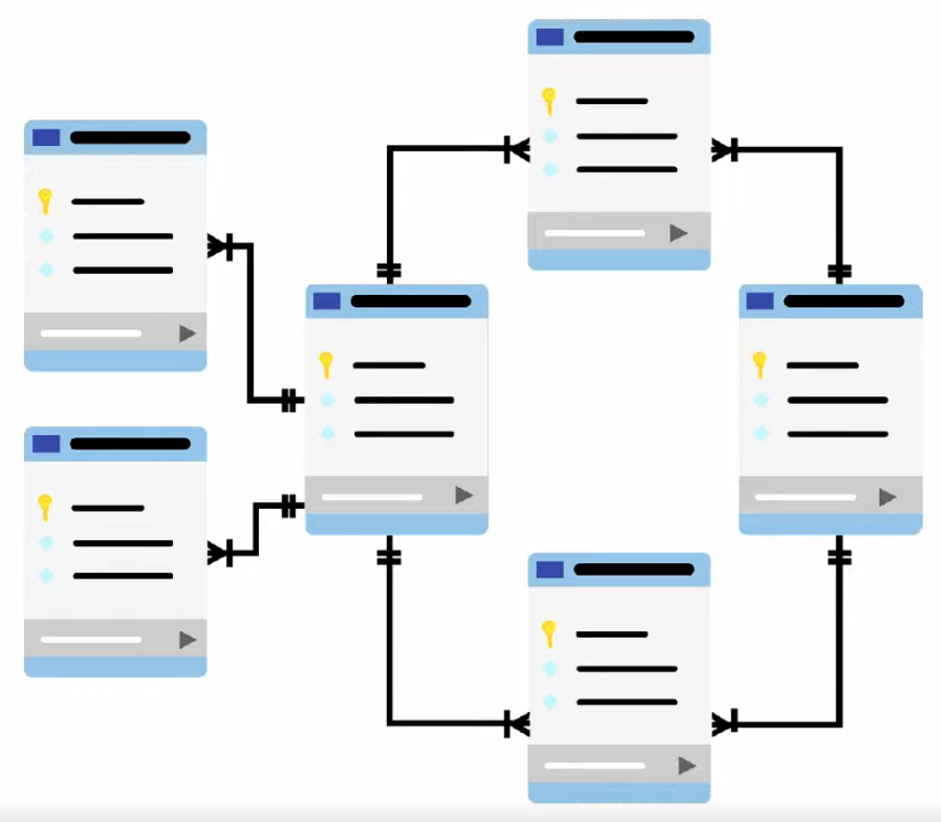
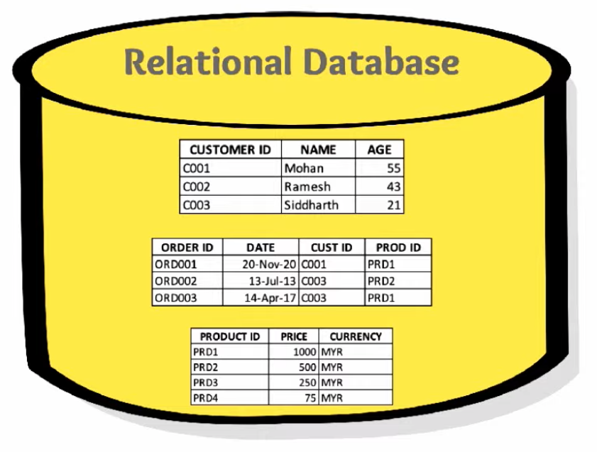

Slide 15
Is SQL different in different RDBMS ?
Oracle
MySQL
Microsoft SQL Server (MSSQL)
PostgreSQL
Refer below link to know popular databases:
https://db-engines.com/en/ranking

Slide 16
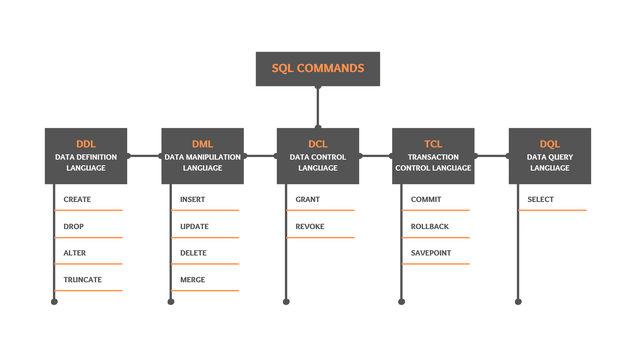

Slide 17
DDL Commands
Data Definition Language
Used to define the structure of a database object such as Table, Views, Procedure, Function etc.
Commands include:
CREATE
ALTER
DROP
TRUNCATE

Slide 18
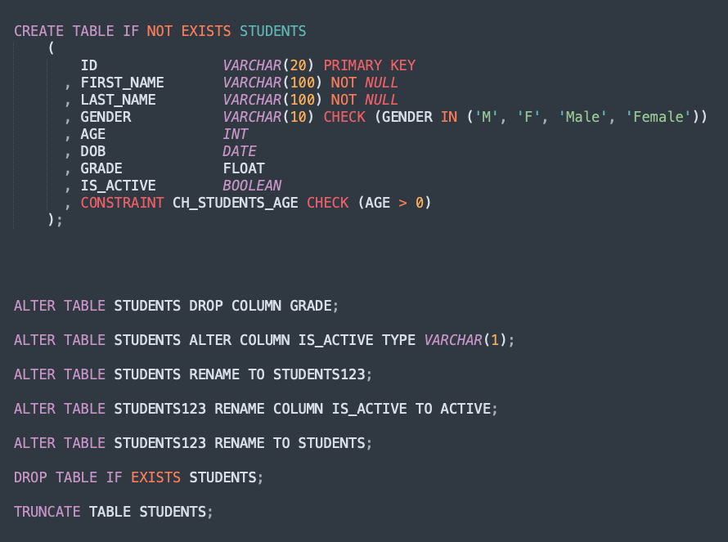

Slide 19
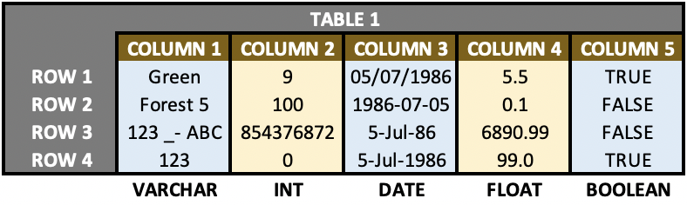
Data Type
INT / NUMBER
VARCHAR / STRING
DATE
FLOAT / DECIMAL
BOOLEAN

Slide 20
Constraints
CHECK constraint allows you to control the values that can be inserted into a column.
By applying NOT NULL constraint on a column, you make sure that this column will never have NULL values.
UNIQUE constraint makes sure that the values in your column are always unique. It can have NULL values.
A table can only have one PRIMARY KEY constraint. Primary key constraint can either be applied to a single column or to a combination of different columns. If a column (or if a combination of multiple columns) is defined as a primary key, then this column/columns will always have unique values across all the rows of that table. Also, primary key column cannot have null values hence primary key can be treated as a combination of UNIQUE and NOT NULL constraints.
FOREIGN KEY constraint can be used to form relation between tables. It basically helps to create a master child relation between 2 tables.

Slide 21
DML Commands
Data Manipulation Language
DML commands are used to load, modify and remove data from the database.
Commands include:
INSERT
UPDATE
DELETE
MERGE

Slide 22
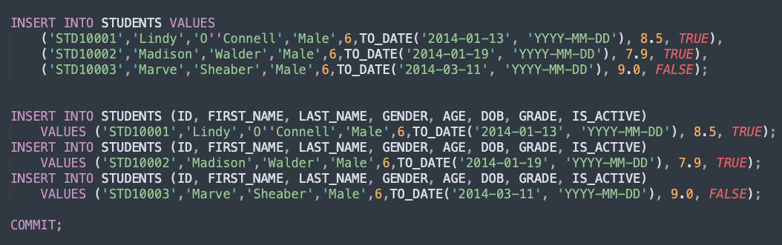
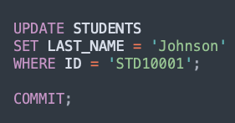
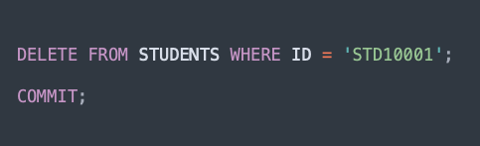

Slide 23
TCL Commands
Transaction Control Language
Includes COMMIT, ROLLBACK and SAVEPOINT
Used to save/unsave open transactions in a database session

Slide 24
DCL Commands
Data Control Language
Includes GRANT and REVOKE statements.
Used to provide or remove permission on a database object to a database user.

Slide 25
DQL Commands
Data Query Language
Includes only the SELECT statement
Can be used to read data from one or multiple tables.
Contains following clauses:
SELECT – list of columns
FROM – list of tables
WHERE – filter conditions and join conditions
Can also include following clauses:
GROUP BY – Grouping of data based on specified column(s)
HAVING – Filter condition for the grouped data
ORDER BY
LIMIT / TOP

Slide 26
Thank you!
Questions ?

